Slide 1

Deccan Education Society’s
FERGUSSON COLLEGE (AUTONOMOUS),PUNE-4
A Project Report On
“ONLINE OPTICIAN SHOP"
M.SC (Computer Science) (2022-2023)
Developed By:
Gayatri Patil
Purva Kale
Revati Jadhav
Under the guidance of:
Prof. Mr. Irfan Khatik
(Department of Computer Science)

Slide 2
CERTIFICATE
This is certified that the project on
" ONLINE OPTICIAN SHOP "
This is to certify that the project entitled ONLINE OPTICIAN SHOP
completed by
Gayatri Patil
Purva Kale
Revati Jadhav
in partial fulfillment of the requirement of the completion of M.Sc(C.S.)Semester-I, has been carried
out by team under my guidance satisfactorily during the academic year 2022-2023.
Mr. Irfan Khatik (Dr. Kavita A.Khobragade)
Project Guide Head Computer ScienceDepartment

Slide 3

ONLINE OPTICIAN
SHOP

Slide 4
PROBLEM DEFINITION:-
Managing your Optical Shop Management System may seem tricky, but an Optical Shop Management System is a part of E-commerce Service System (Application support direct contact with users).
• Existing systems are not user friendly.
• Admin panel need improvement for getting more options for easy working.
• Optical Shop Management System searching option need more filters.

Slide 5
SCOPE OF THE PROJECT:-
The project has a wide scope, as it is not intended to a particular organization. This project is going to develop generic software, which can be applied by any businesses organization. More over it provides facility to its customers. Also the software is going to provide a huge amount of description of every product.

Slide 6
Purpose
To manage Optical Shop Management System. It helps to customers to search via various type of Glass list, Buy glasses from anywhere. Also make payment online for it. It helps to people to find and Buy Glass online.
Proposed System
The Optical Shop Management System is available in the market that can serve customers to find and Buy Optical Shop online

Slide 7
Software/hardware specification
Requirements:
• Microsoft Windows 7 OR Higher
Hardware Requirements:
• Intel Processor 2.0 GHz
• 2 GB RAM or more.
• 160 GB or more Hard Disk Drive or above

Slide 8
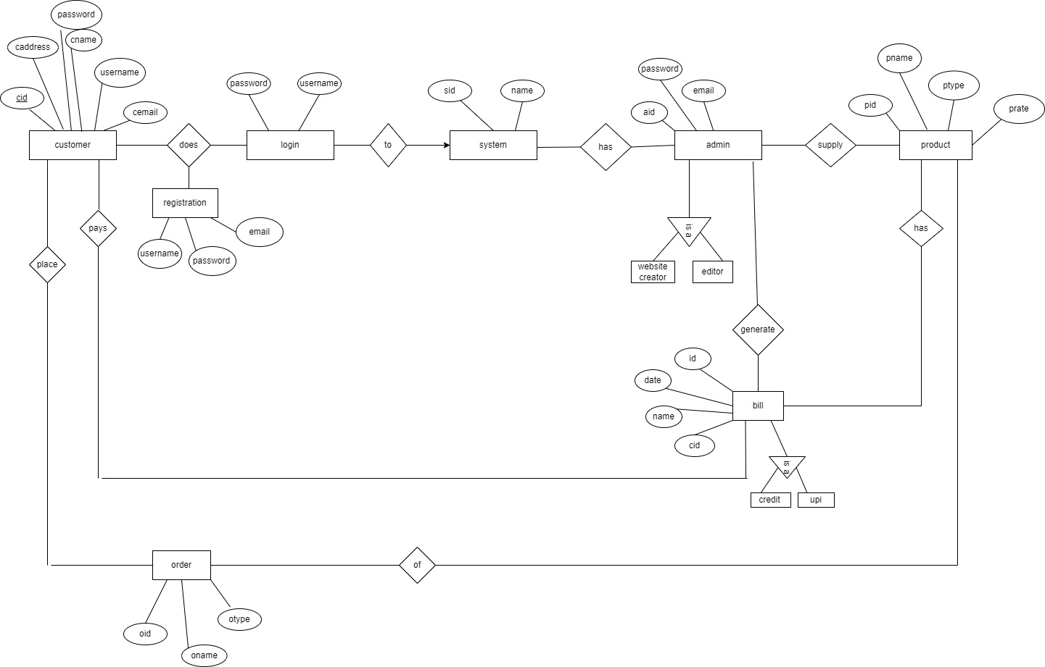
E-R DIAGRAM:-
E-R DIAGRAM
ER Diagram stands for Entity Relationship Diagram, also known as ERD is a diagram.
That displays the relationship of entity sets stored in a database. In other words, ER diagrams help to explain the logical structure of databases.
ER diagrams are created based on three basic concepts: entities, attributes and relationships.
ER Diagrams contain different symbols that use rectangles to represent entities, ovals to define attributes and diamond shapes to represent relationships.
At first look, an ER diagram looks very similar to the flowchart.

Slide 9
username
password
name
Phone no
email
login
goes
username
Select frame
customer
password
Glass page
does
Select glass
goes
payment

Slide 10
Use case diagram:- Admin
Use case diagram :
A use case diagram is used to represent the dynamic behavior of a system.
It encapsulates the system's functionality by use cases, actors, and their relationships.
Following are the purposes of a use case diagram given below:
It gathers the system's needs.
It is process of external view of the system.
It recognizes the internal as well as external factors that influence the system.
It represents the interaction between the actors.
Add Glasses
ADD FRAME
View
ADMIN
SYSTEM
View sale
Details
Use Case Diagram between ADMIN and SYSTEM

Slide 11

Use case diagram:-user
Sign In
Add Glasses and
Add frame
Buy now
USER
SYSTEM
Use Case Diagram between USER and SYSTEM:

Slide 12
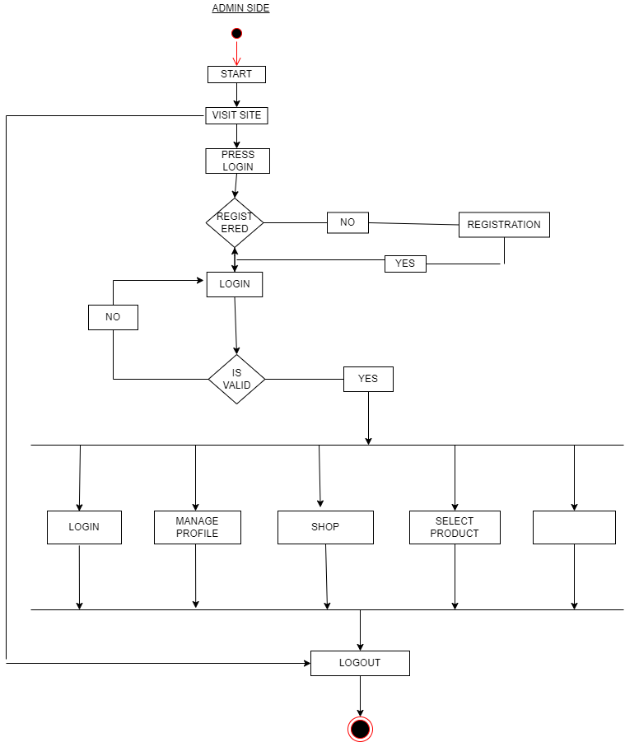
Activity Diagram ADMIN SIDE:-
Activity diagram :
The activity diagram helps the workflow from one activity to another.
The flow can be sequential, branched, or concurrent, and to deal with such kinds of flows, the activity diagram has come up with a fork, join, etc.
It is the same as that of a flowchart but not exactly a flowchart itself.
It is used to depict the flow between several activities.

Slide 13

CUSTOMER SIDE:

Slide 14
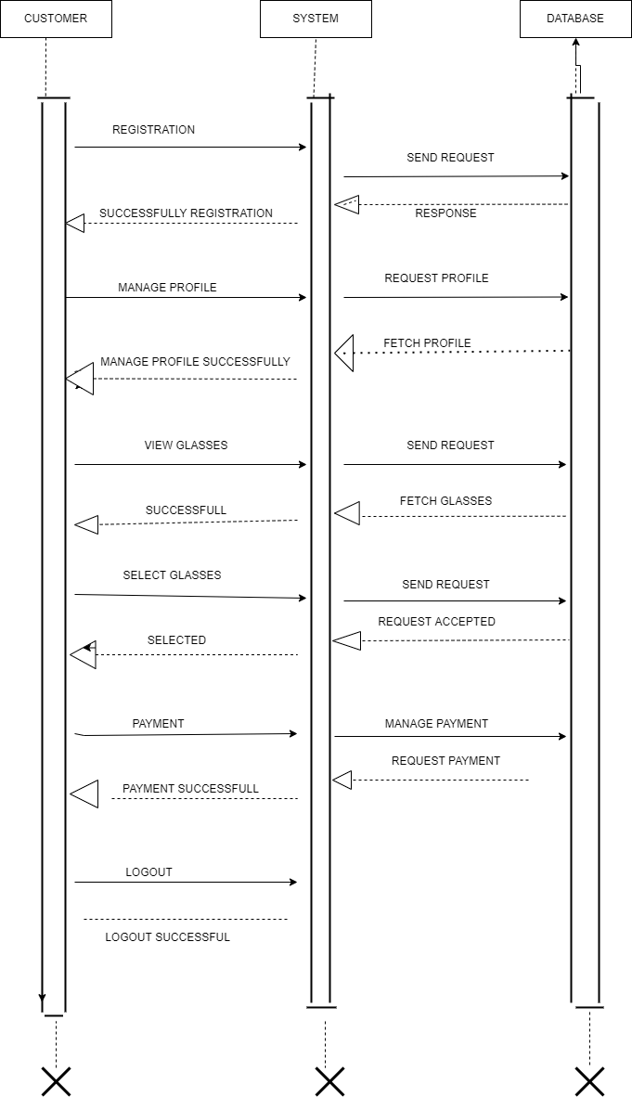
SEQUENCE DIAGRAM : ADMIN SIDE

Slide 15

SEQUENCE DIAGRAM: CUSTOMER SIDE

Slide 16
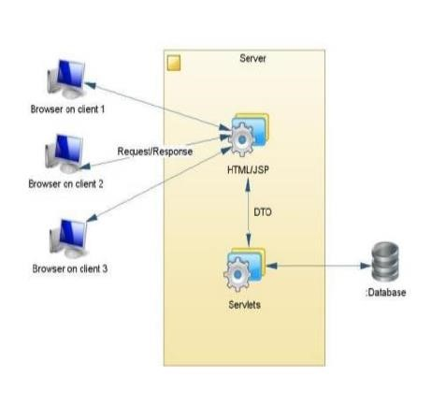
COMPONENT DIAGRAM:-

Slide 17
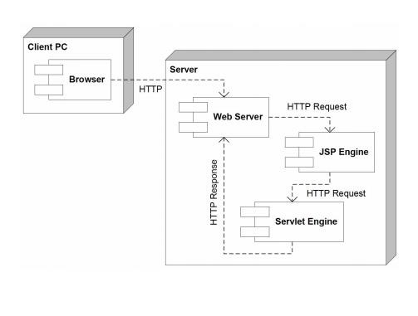
DEPLOYMENT DIAGRAM:-
Deployement Diagram:
The deployment diagram visualizes the physical hardware on which the software will be deployed.
It portrays the static deployment view of a system. It involves the nodes and their relationships.
The main purpose of the deployment diagram is to represent how software is installed on the hardware component. It depicts in what manner a software interacts with hardware to perform its execution.

Slide 18
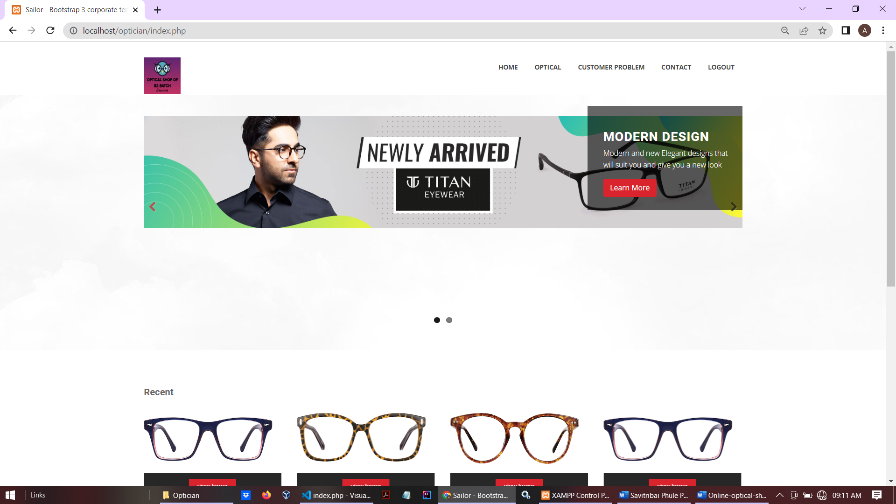
HomePage

Slide 19
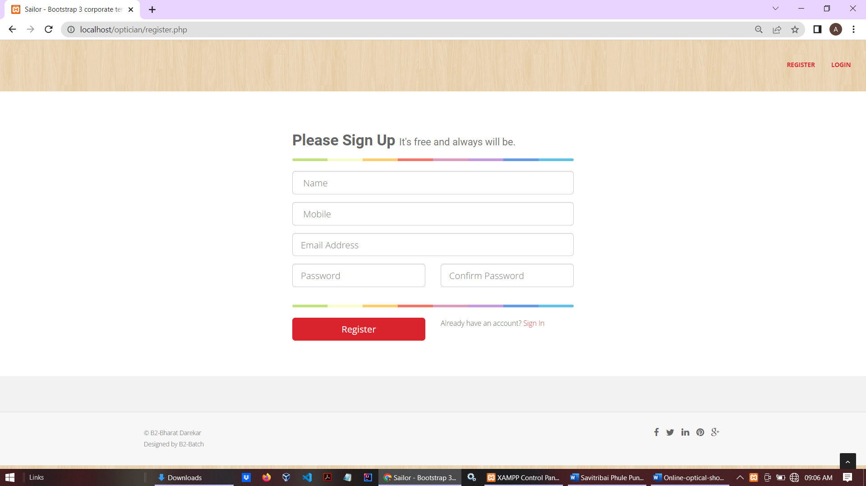
New registration page

Slide 20
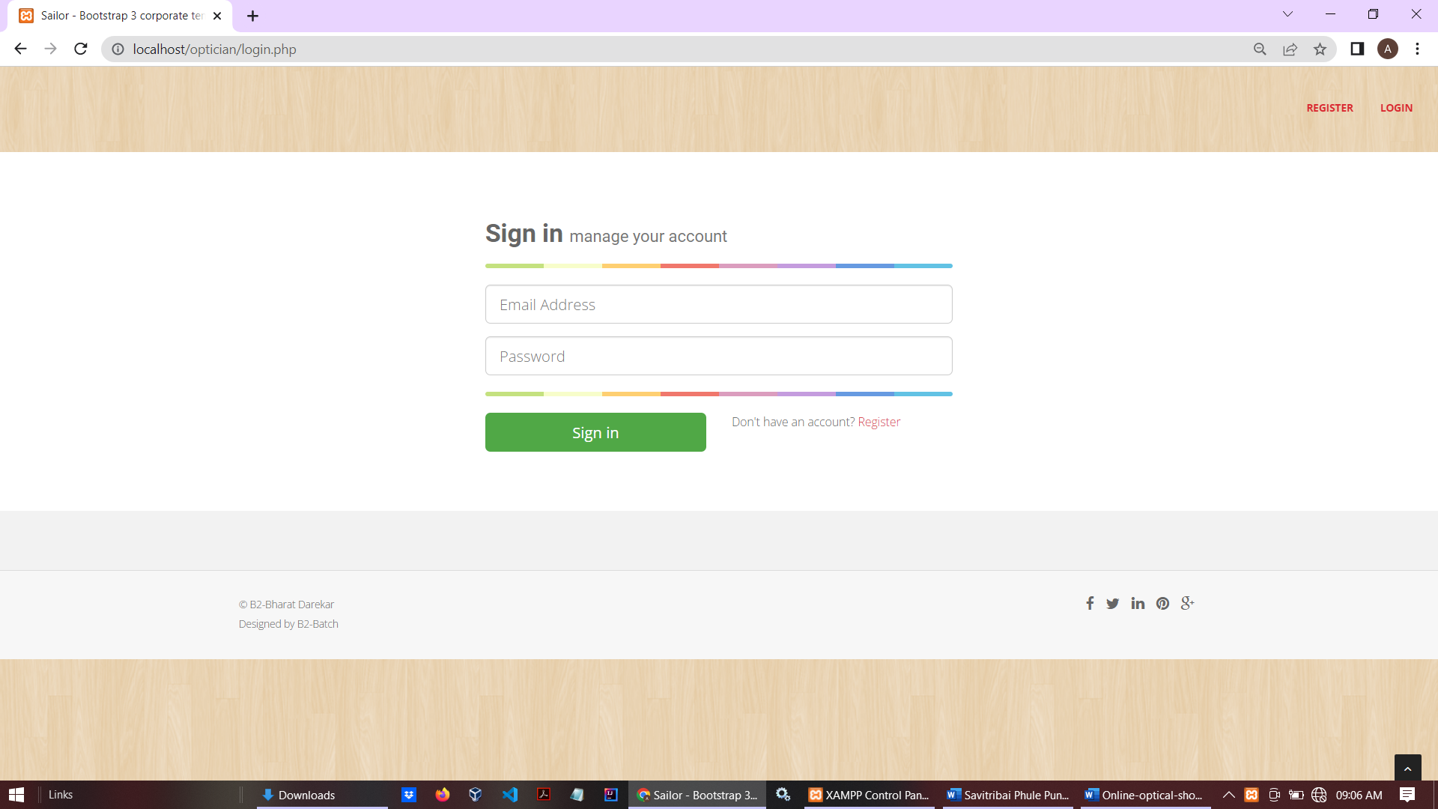
Sign in page

Slide 21
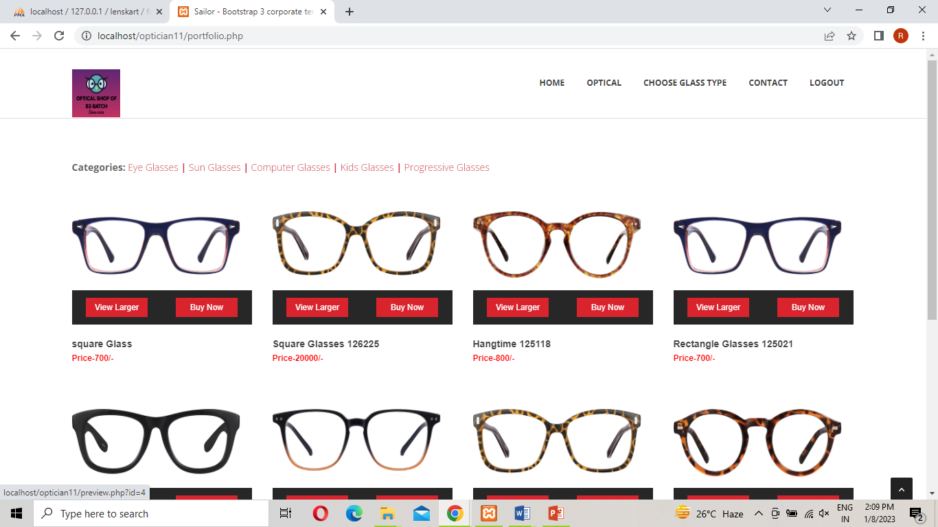
New Glass Page

Slide 22
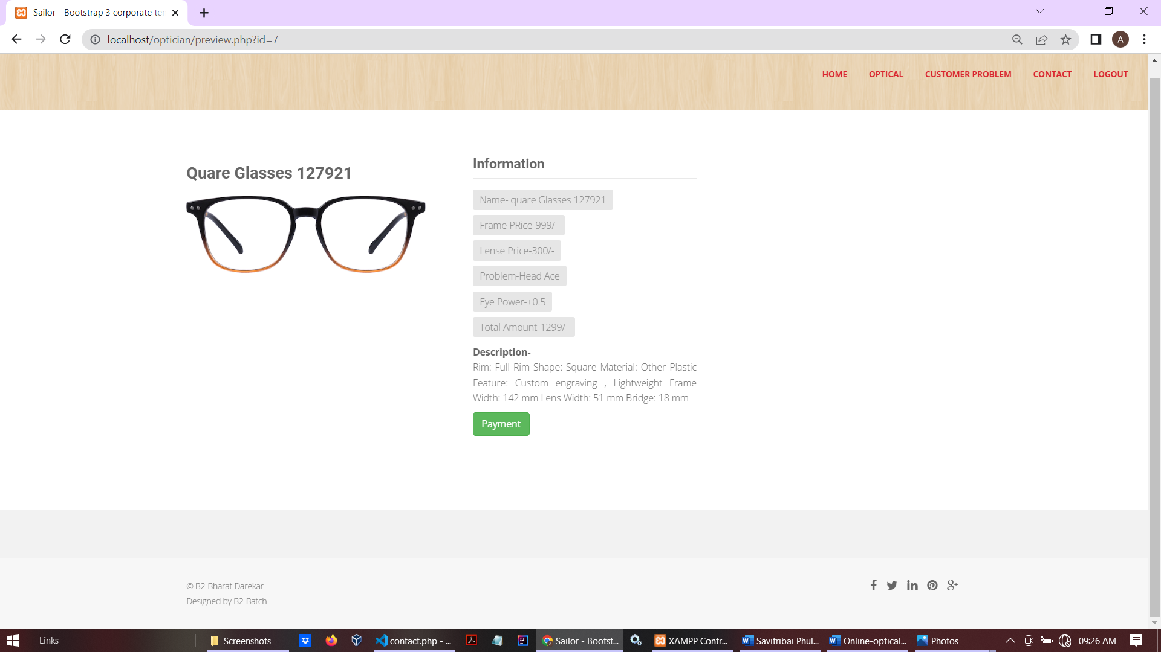
Glass details

Slide 23
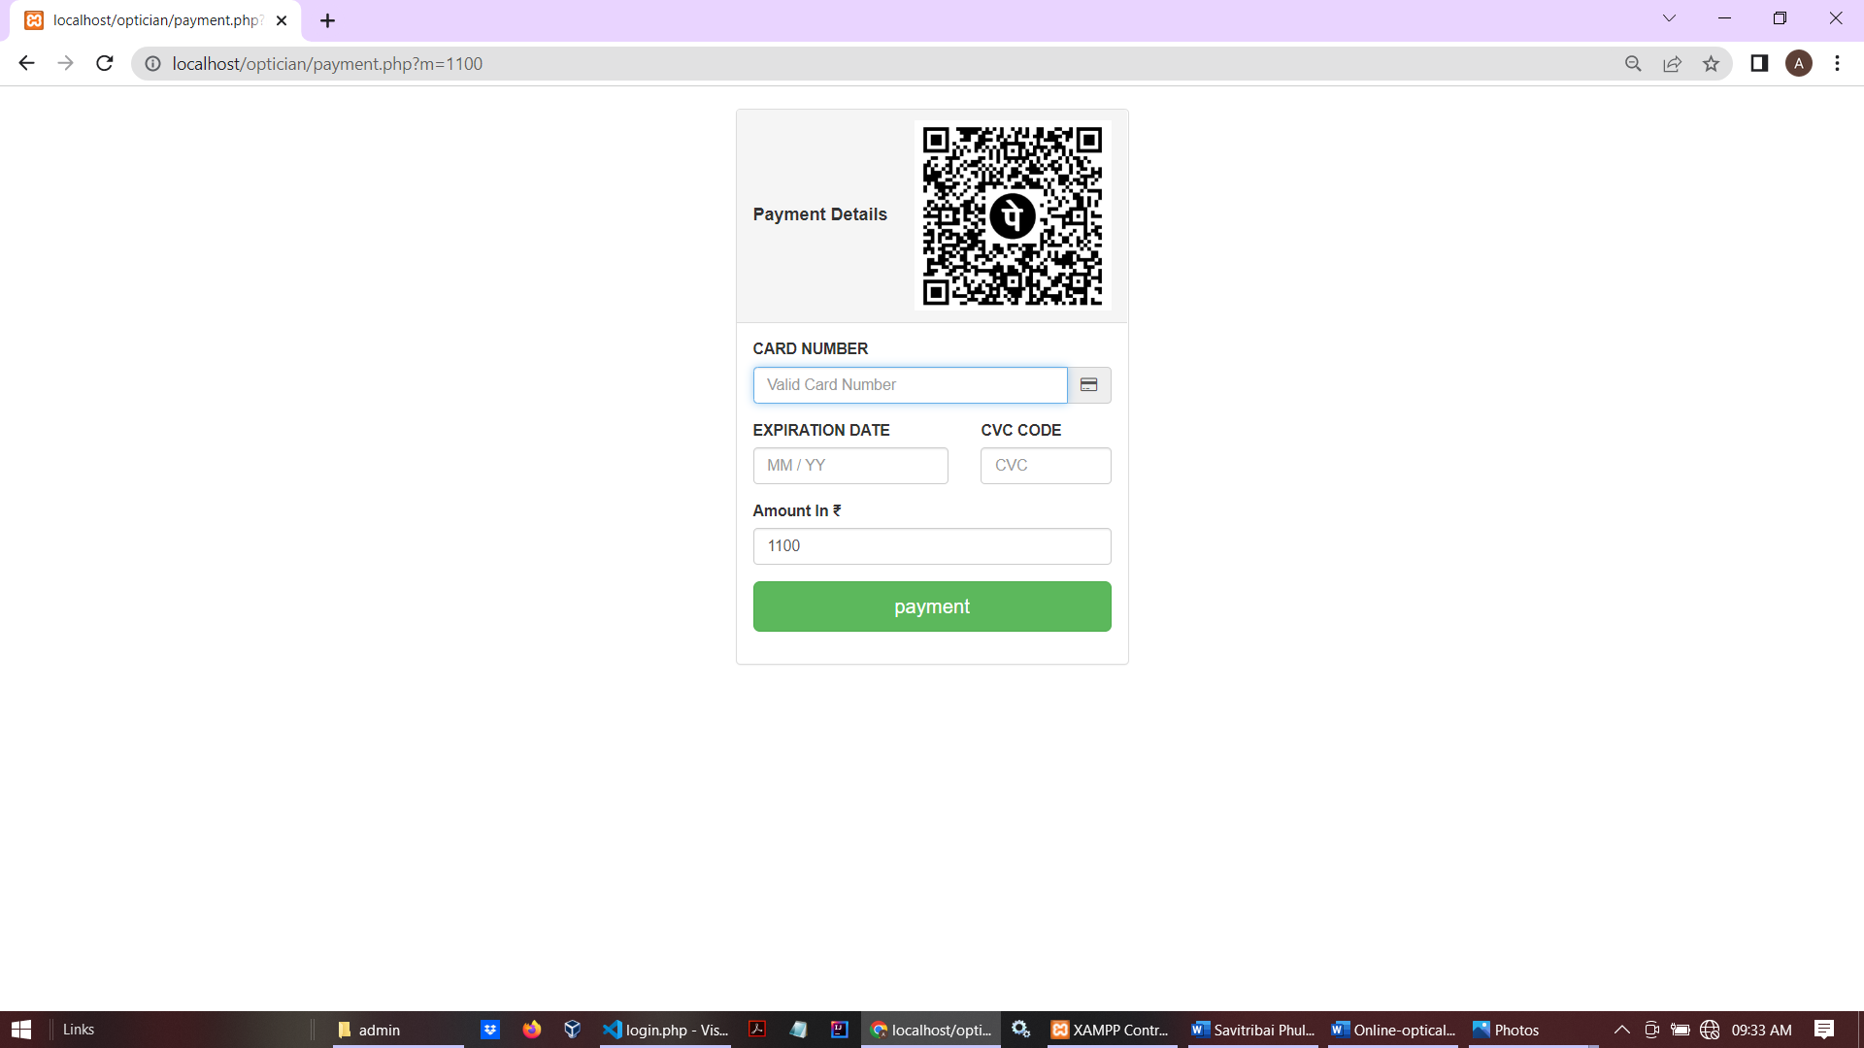
Payment Details

Slide 24
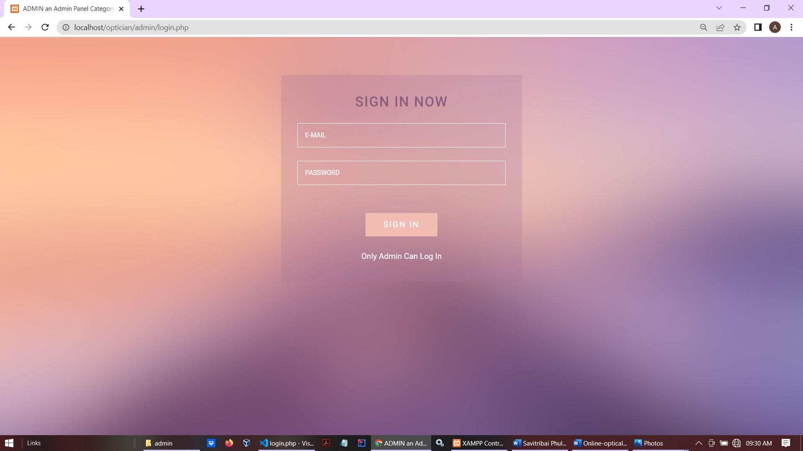
Admin login Page

Slide 25
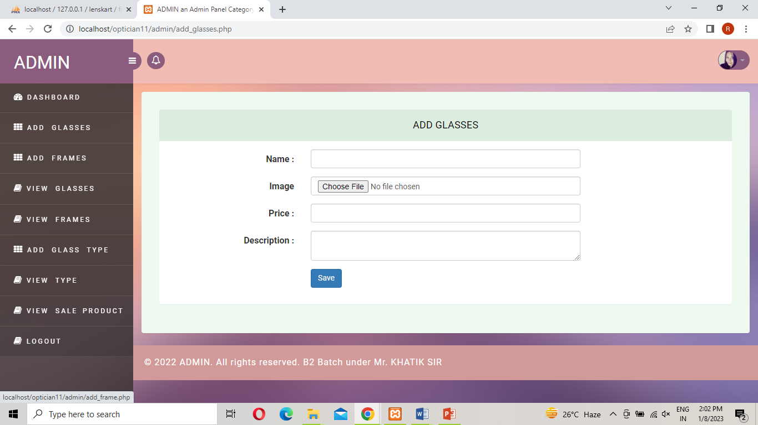
Dashboard

Slide 26
Add Glasses

Slide 27
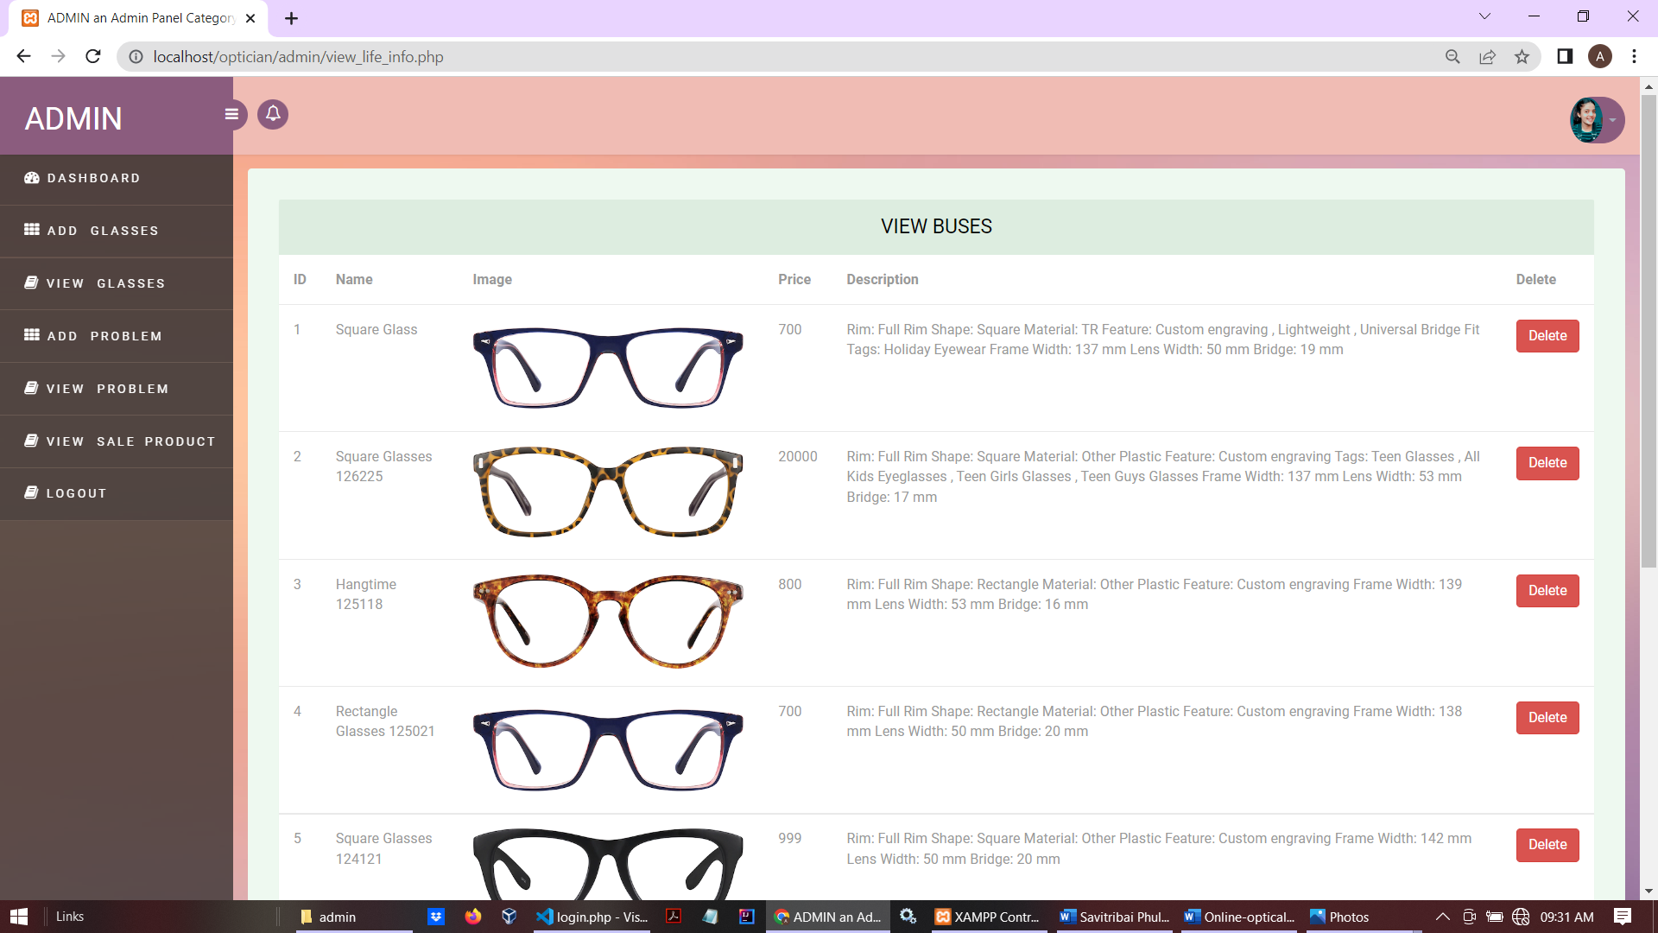
View and Delete Glasses

Slide 28
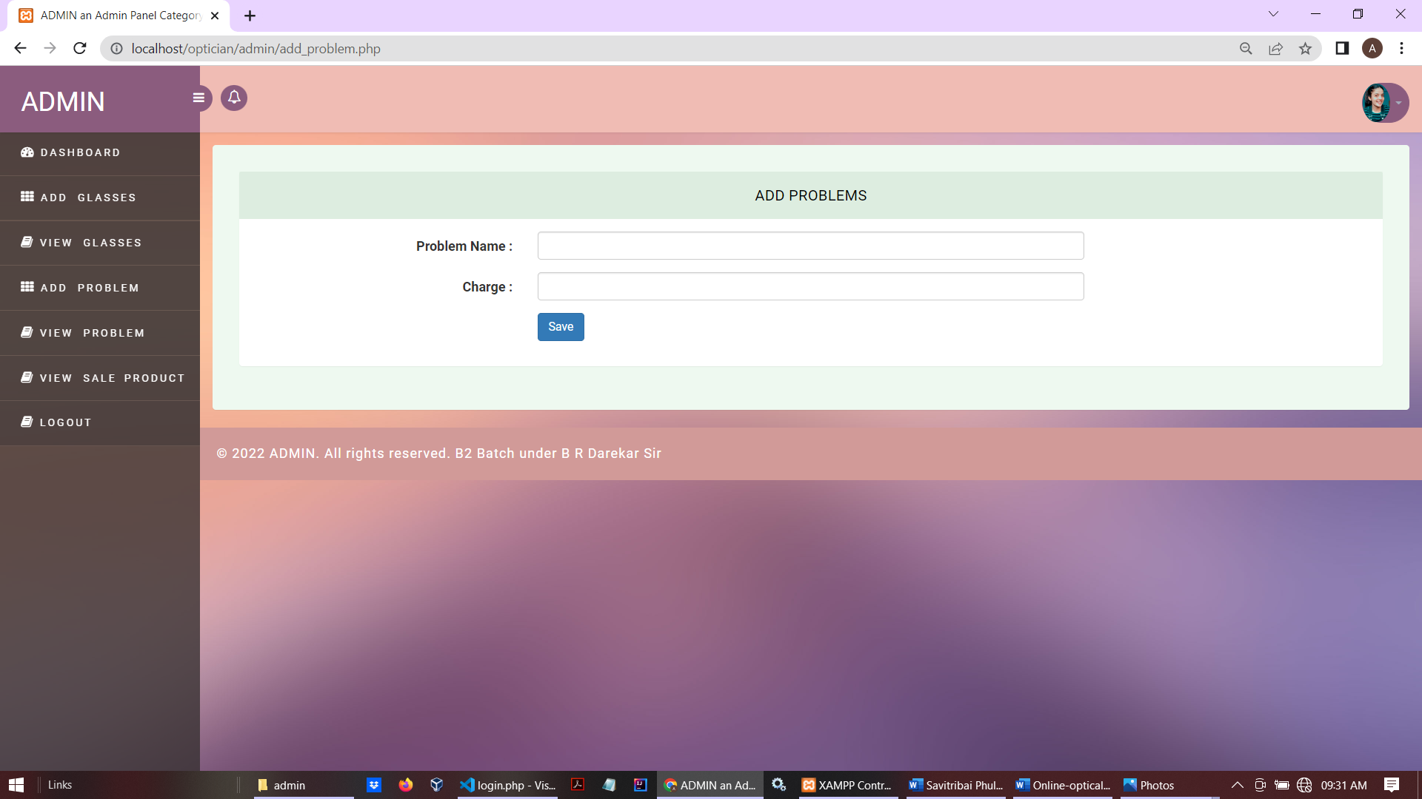
Add Problems

Slide 29
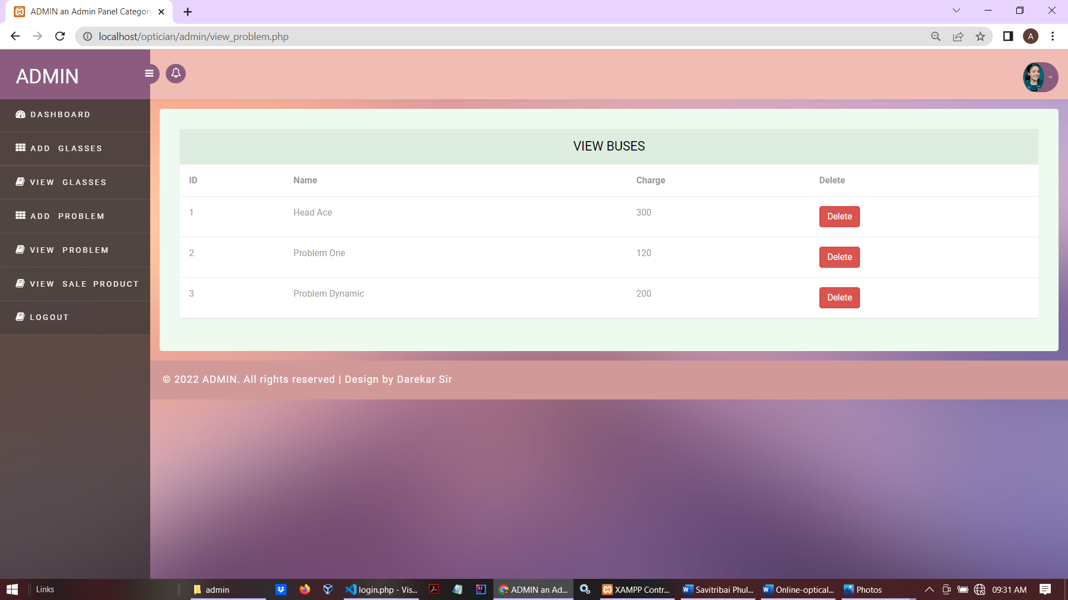
View problems

Slide 30
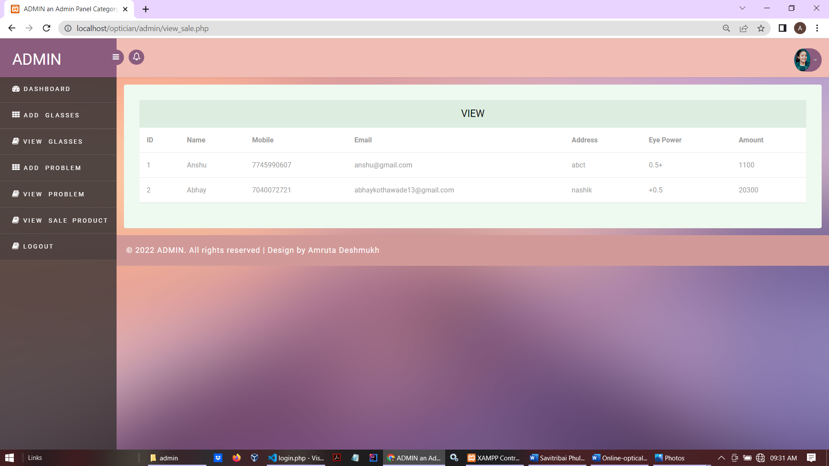
Payment Records

Slide 31
ADVANTAGES AND LIMITATIONS:
Advantages of “Optical Shop Management System”:
“Optical Shop Management System” provides various features, which complement the information system and increase the productivity of the system. These features make the system easily usable and convenient. Some of the important features included are listed as follows:
Intelligent User Forms Design
Data access and manipulation through same forms
Access to most required information
Data Security
Restrictive data access, as per login assigned only.
Organized and structured storage of facts.

Slide 32
Limitations of “Optical Shop Management System”:
Besides the above achievements and the successful completion of the project, we still feel the project has some limitations, listed as below:
It is not a large-scale system.
Only limited information provided by this system.

Slide 33
CONCLUSION:-
This system has been developed for OM OPTICAL SHOP. The current system is a manual system .In order to overcome the drawbacks in the current system a decision to automate some of the department of the optical shop business . It reduces drawback of manual system like provide security time consuming, do not require any extra storage, easily modify the data ,fast and accurate. This System provide better service to the customer.

Slide 34
FUTURE SCOPE:-
• Getting accurate information about what kind of books user likes and this information in cookies, by which we can show recommended books to user.
• We offer Low price and best Offer for Optical Shop Management System also in future.

Slide 35
BIBLOGRAPHY:-
➢ FOR PHP INSTALLATION
• http://www.php.net/
➢ FOR DEPLOYMENT AND PACKING ON SERVER
www.developer.com
www.15seconds.com
www.projecttunnel.com
➢ FOR MY SQL
• http://www.mysql.com/
➢ FOR CSS
• http://cssed.sourceforge.net/
➢ FOR APACHE
• http://www.apache.org/

Slide 36
➢ FOR OTHER USEFUL REFERENCES
• http://www.eclipse.org/pdt/
• http://www.w3schools.com/default.asp
• http://en.wikipedia.org/

